Slide 1
Dimensionality Reduction
Aug 3, 2023
Thu 4 PM
Introduction to Artificial Intelligence - 2023 Summer
Kwangwoon University MI:RU
Artificial Intelligence Study

Slide 2
Agenda
In this course, you will learn
Part 1 – Quick Review: Norm and Covariance
Part 2 – What is Curse of Dimensionality?
Part 3 – Projection and Dimensionality Reduction

Slide 3
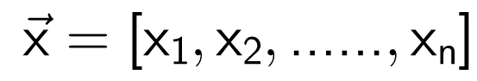
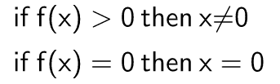
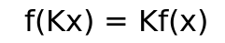
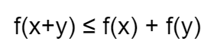
Quick Review: Norm in Linear Algebra
What is Norm?
X: a vector
Norm: a function that returns length/size of any non-zero vector
Conditions for norm function
If these conditions are satisfied, then the functions is a norm

Slide 4
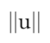
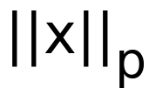
Quick Review: Norm in Linear Algebra
Commonly used notations
The p-norm of vector x
If p has not given, then it usually means 2-norm

Slide 5
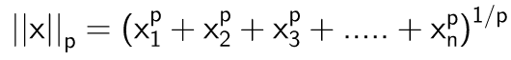
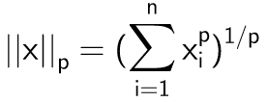

Quick Review: Norm in Linear Algebra
Commonly used notations
Simplified form

Slide 6

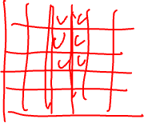
Quick Review: Norm in Linear Algebra
Manhattan Distance (1-norm, L1-norm)
Grid-like path

Slide 7
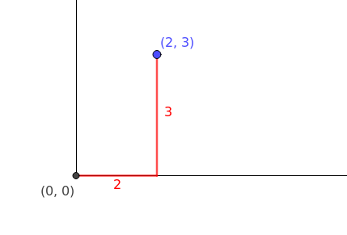
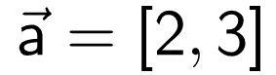
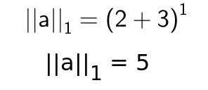

Quick Review: Norm in Linear Algebra
Manhattan Distance (1-norm, L1-norm)
Let’s assume we have a vector “a”
1-norm could be represented in this form

Slide 8
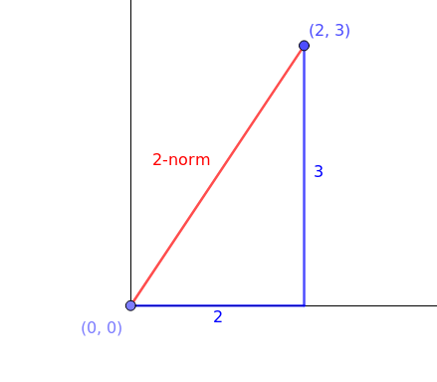
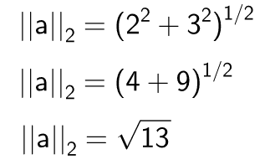
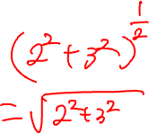
Quick Review: Norm in Linear Algebra
Euclidean Distance (2-norm, L2-norm)
2-norm could be represented in this form

Slide 9
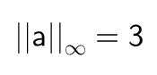
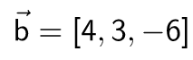
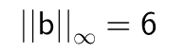
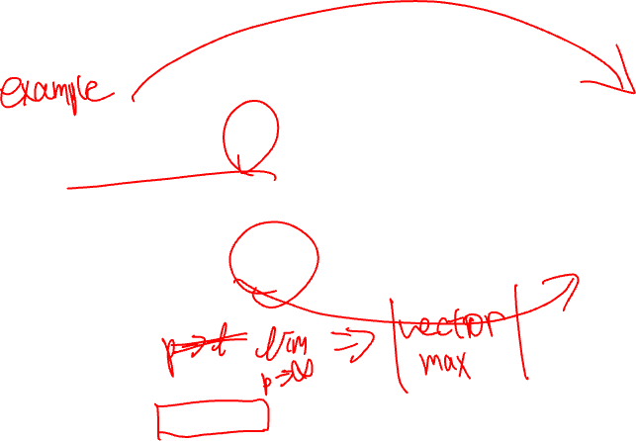
Quick Review: Norm in Linear Algebra
Infinity-norm
Infinity-norm returns maximum absolute value in the given vector

Slide 10
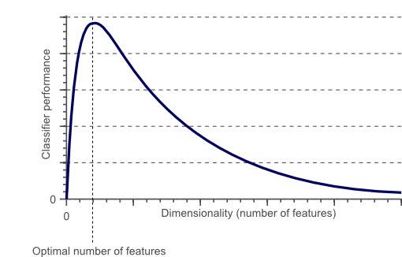

What is Curse of Dimensionality?
Wrong example

Slide 11
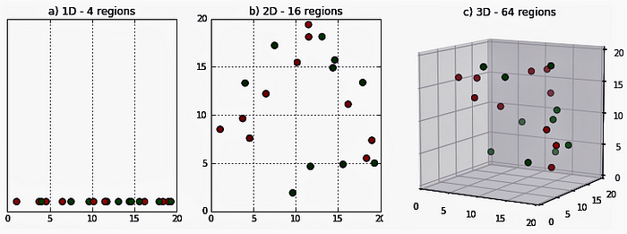
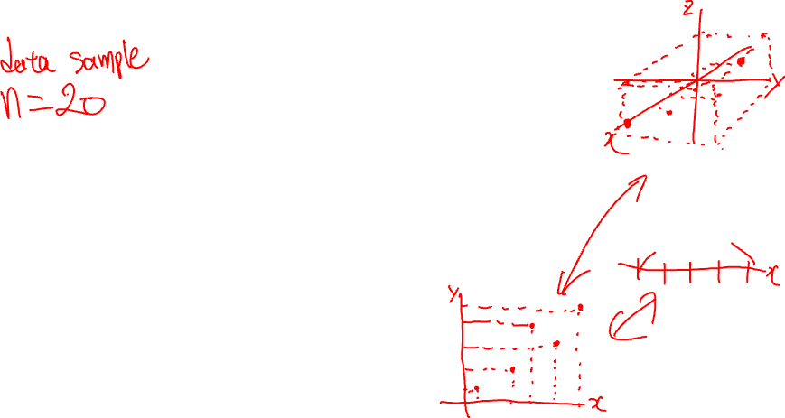
What is Curse of Dimensionality?
In perspective of density

Slide 12
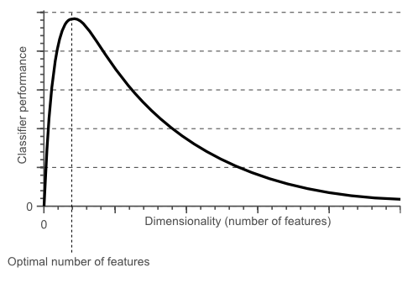
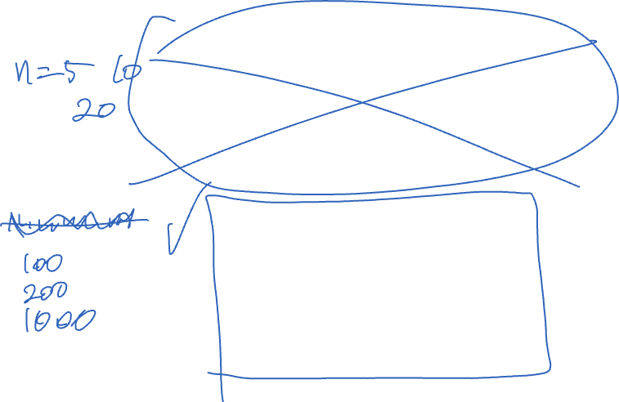
What is Curse of Dimensionality?
In perspective of density

Slide 13
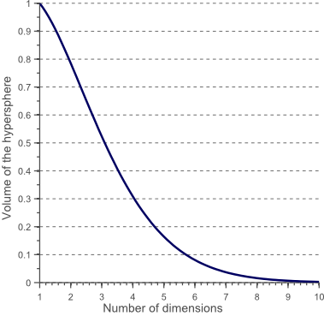
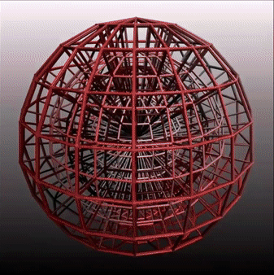
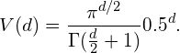

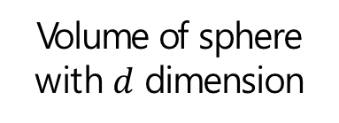
What is Curse of Dimensionality?
In perspective of density
A hypersphere
Volume of sphere with $d$ dimension
The volume of the hypersphere

Slide 14
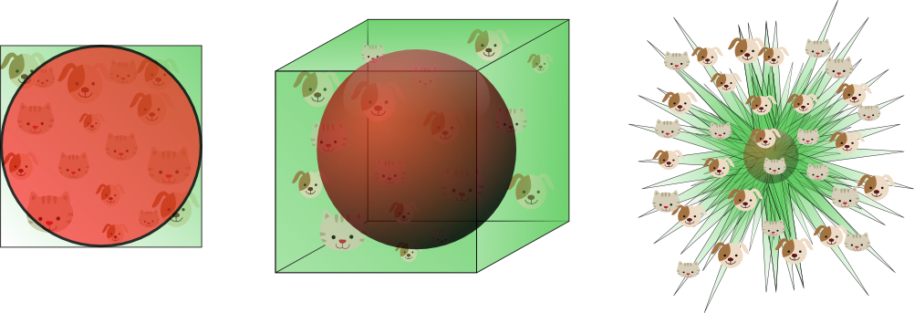
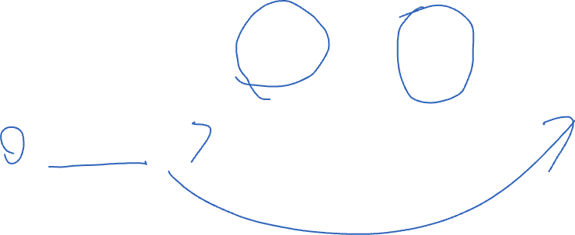
What is Curse of Dimensionality?
In perspective of density
The volume of the hypersphere

Slide 15
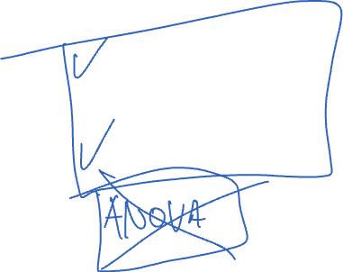
What is Curse of Dimensionality?
Ways to handle this problem
Reduce the dimension
Or
Get more data

Slide 16
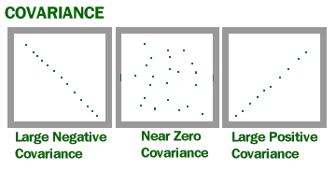
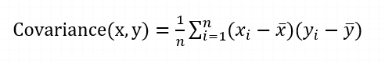

Projection and Dimensionality Reduction
Covariance

Slide 17
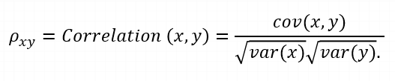
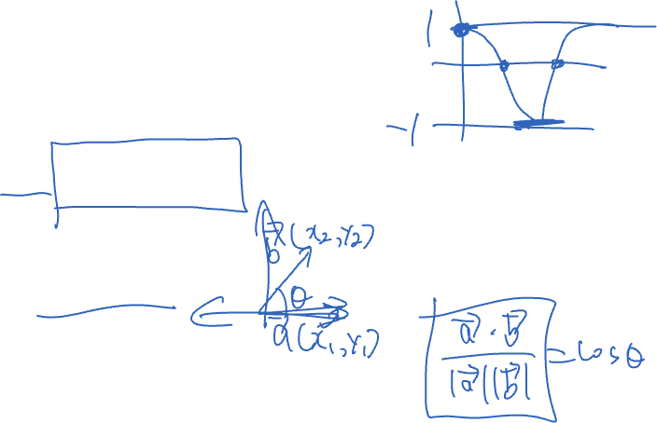


Projection and Dimensionality Reduction
Covariance
Covariance != Correlation
Joint variability of two random variables
Relationship between two variables
Range: $\left[−infty, infty\right]$
Range: $\left[−1, 1\right]$

Slide 18
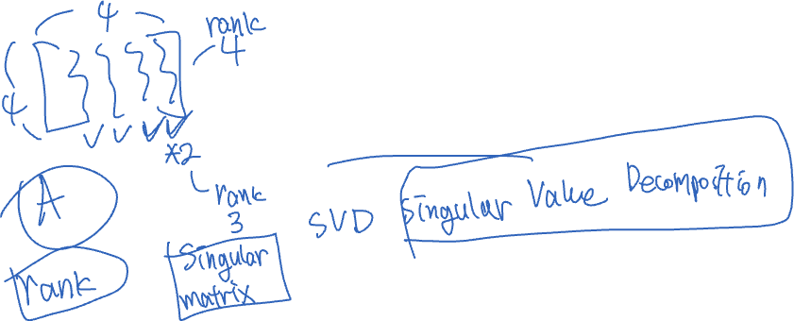
Projection and Dimensionality Reduction
Principal Component Analysis (PCA)
Principal Component Analysis
Extracting Principal Components
How do we extract?
Eigenvalue, Eigenvector!

Slide 19
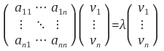
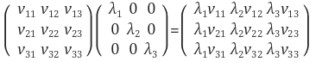
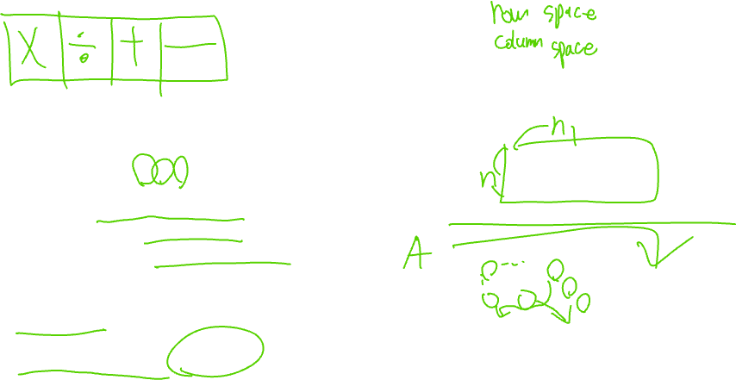
Projection and Dimensionality Reduction
Principal Component Analysis (PCA)
Eigenvalue decomposition
= Linear transform of a matrix
A is a square matrix
v is an eigenvector
lambda is an eigenvalue
Number of Eigenvector can be 0 to n
If the result of linear transform is multiplication non-zero itself: eigenvector
Multiplied constant: eigenvalue
Eigenvalue and Eigenvector of A
: $λ_{i}$, $v_{i}$

Slide 20
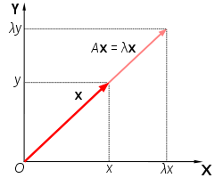

Projection and Dimensionality Reduction
Principal Component Analysis (PCA)
Operation in the previous slide is only for square matrix
For non-square matrix?
➔ Singular Vector Decomposition (SVD)
Matrix A: stretched by x
X didn’t change A’s direction
➔ X is an eigenvector of A!

Slide 21
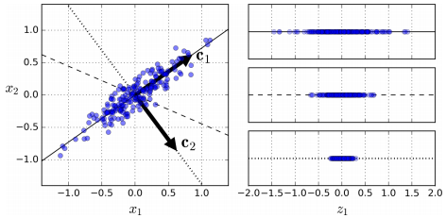
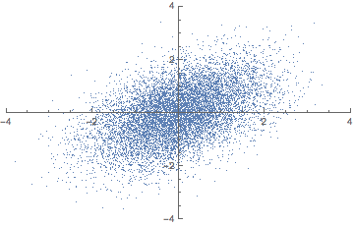
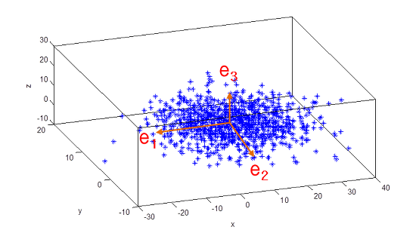
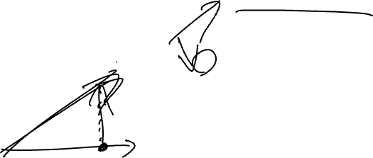
Projection and Dimensionality Reduction
Principal Component Analysis (PCA)
Why should we find the lines that can keep the variance
Variance == Information

Slide 22
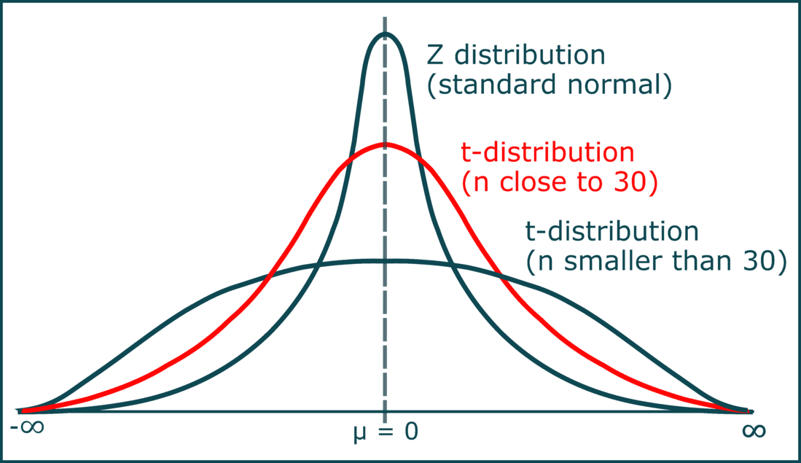
Projection and Dimensionality Reduction
t distribution
Student’s t-distribution
Inference about the population mean when the sample size is small
Or
Population standard deviation is unknown

Slide 23
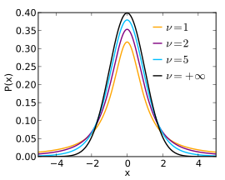
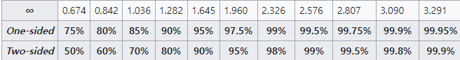
Projection and Dimensionality Reduction
t distribution

Slide 24
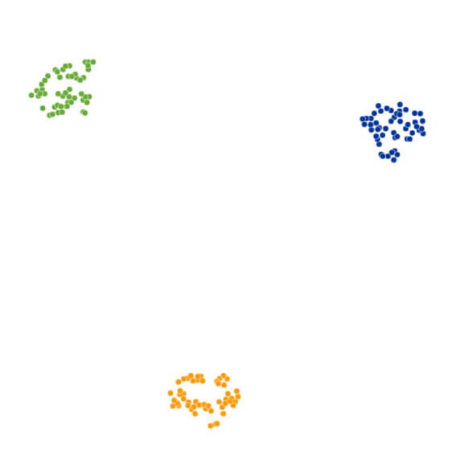
Projection and Dimensionality Reduction
t-SNE t-distributed Stochastic Neighbor Embedding
Plotting high-dimensional data into 2D

Slide 25
Projection and Dimensionality Reduction
t-SNE vs PCA
t-SNE
- Nonlinear technique
- Focuses on preserving the similarities between data points in a lower-dimensional space
PCA
- Linear technique
- Focuses on preserving variance

Slide 26
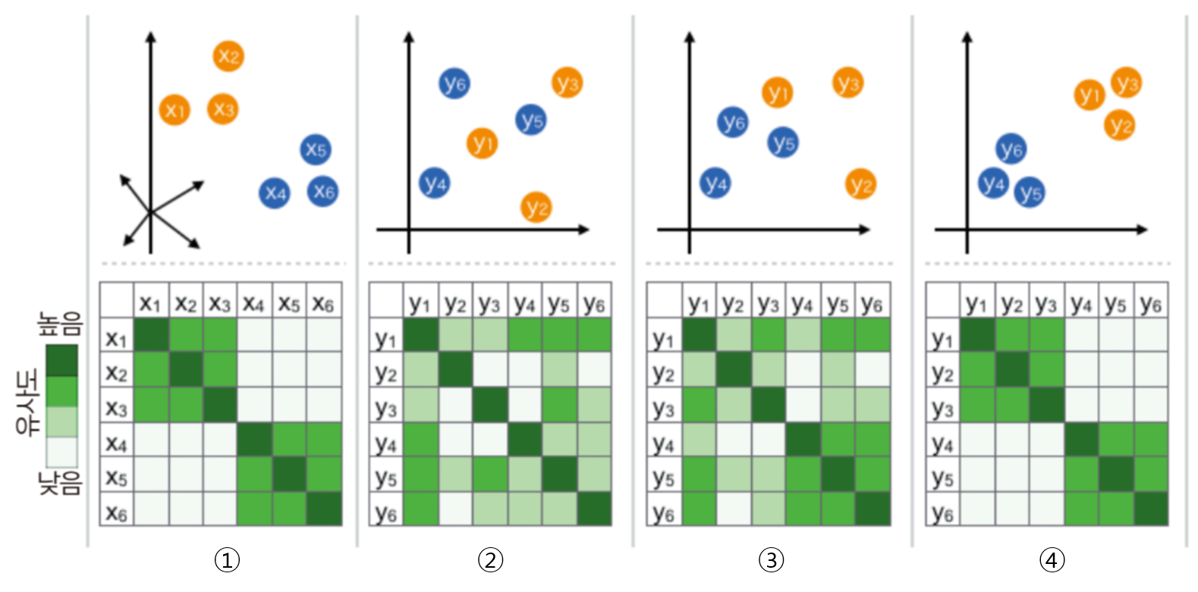
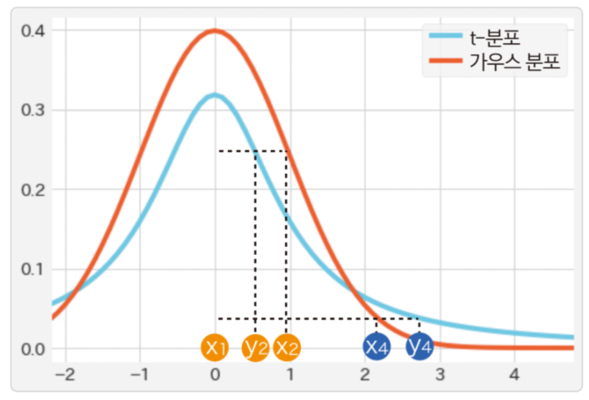


Projection and Dimensionality Reduction
t-SNE
Similarities in the heatmap are Gaussian distribution, similarity of $x_{i},x_{j}$ Map $y_{i}$ into lower dimension randomly
Calculate similarity of $y_{i},y_{j}$ for all $i, j$ pairwise using t-distribution

Slide 27



Projection and Dimensionality Reduction
t-SNE
Why they used t-distribution?
Heavily tailed ➔ Data in tail are more likely to be selected

Slide 28
References
A Basic Overview of Using t-SNE to Analyze Flow Cytometry Data – Marissa Fahlberg, PhD
t-SNE 개념과 사용법 - gaussian37
Eigen decomposition and Principal Component Analysis | Machine Learning | Clairvoyant Blog (clairvoyantsoft.com)

